Slide 1
WorldVisitz Mobile Application Agile Delivery Launch
Agile Onboarding - Presentation for the Agile Team
Presented by: Salma Attia
© 2019 Udacity. All rights reserved.

Slide 2
Onboarding the Team

Slide 3
Agile Benefits for the Team
Benefit | What It Means for the Team
Clear Priorities | Team always knows what’s most important, reducing confusion and context switching
Faster Feedback | Developers, testers, and designers get early and regular feedback from stakeholders
Shared Ownership | Cross-functional teams share responsibility and decision-making, boosting morale
Predictable Workload | Time-boxed sprints help prevent burnout and support sustainable pace
Continuous Learning | Retrospectives, pair programming, and reviews enable skill growth and team maturity
Collaboration & Transparency | Daily standups and backlog visibility ensure everyone is aligned
Recognition of Contributions | Regular demos let team members showcase their work and feel valued
Notes:
Agile empowers the team—not just to deliver faster, but to own their work, collaborate more deeply, and grow professionally. In the WorldVisitz context, where developers are split across time zones, Agile will help break down silos, build trust, and foster a more collaborative, efficient, and motivated team environment.

Slide 4
Agile Practice

Slide 5
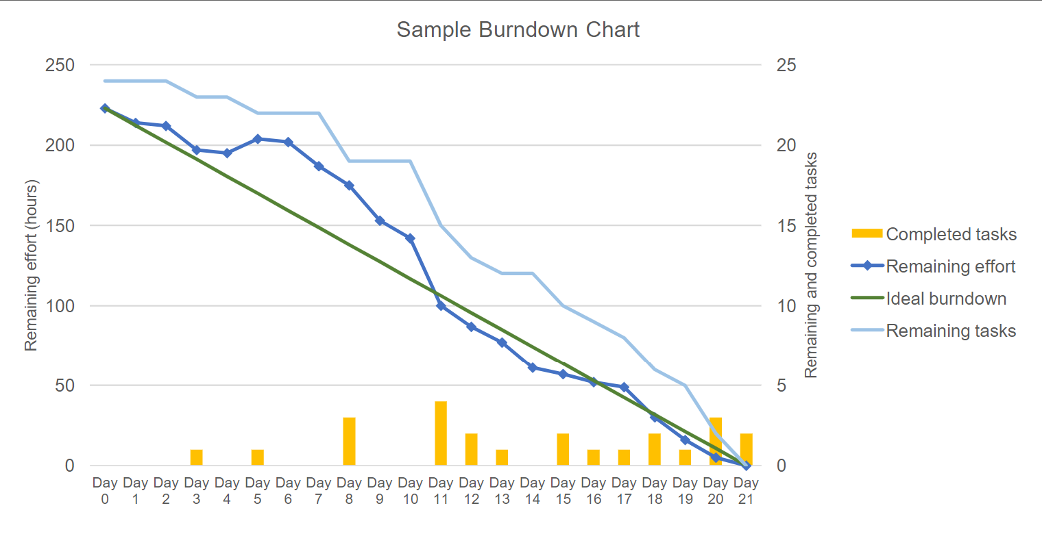
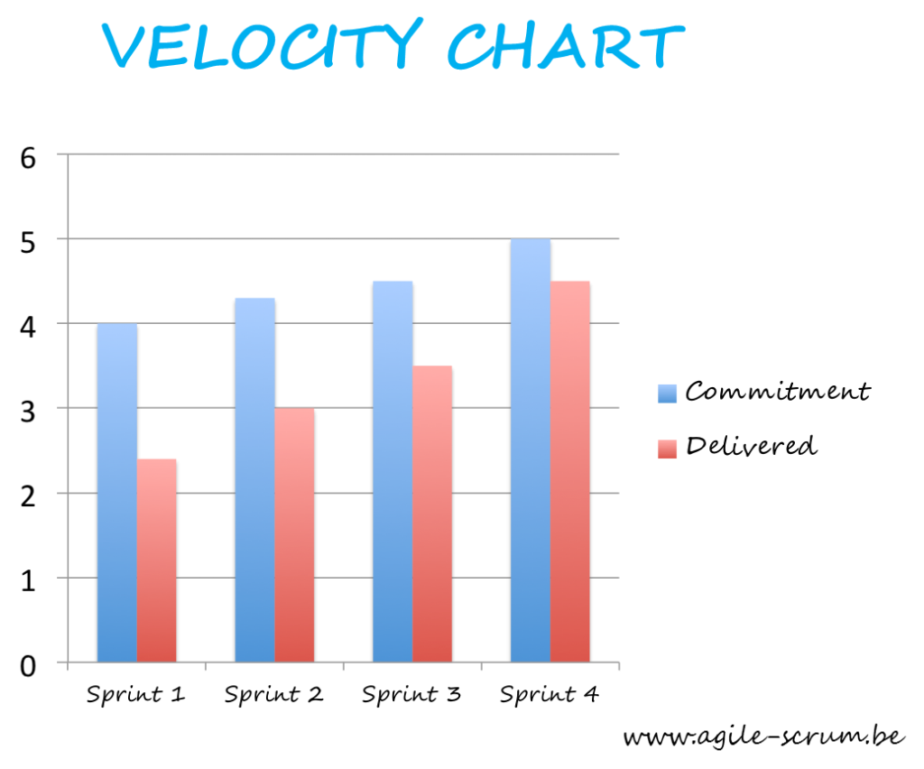
Recommendations for Information Radiators
Radiator | Visual Example | Value Proposition (Why It’s Helpful)
1. Sprint Burndown Chart | Line graph showing work remaining over days in sprint | - Tracks progress against sprint goals - Highlights risks early (e.g., scope creep, delays) - Keeps team focused on completion
2. Velocity Chart | Bar chart showing story points completed per sprint | - Measures team performance over time - Helps forecast future sprint capacity - Useful for sprint planning & stakeholder trust
Burndown Chart
Velocity Chart
Notes:
Our recommendation is a Burndown or Velocity chart. This radiator gives a quantitative picture of how the team is progressing toward completing the sprint goal. It shows if we're on track, ahead, or behind. It also helps in forecasting and planning future sprints more realistically. For stakeholders, it's a powerful visual that communicates progress at a glance

Slide 6
Ceremony Schedule & Each Agenda
Ceremony/Activity | Frequency | Duration | Purpose | Agenda
Project Vision | Project Start | Varies (Workshop) | Establish product purpose, customer needs, and success metrics. | Discuss the project goals identify sponsor outline project vision, success criteria, assumptions, constraints, and risks.
Sprint Planning | Start of Sprint | 2 hours | Define sprint goal, select backlog items, break into tasks. | Agile Team works with the PO and Scrum Master to address the following three questions: What are we committing to deliver in the upcoming Sprint? How will we complete the work required to achieve this commitment? What are the respective estimates for each user story and associated tasks?
Daily Scrum | Daily | 15 minutes | Team sync on progress, blockers, and next steps. | Three questions are addressed by each Team member : What did I do since the last time we met? What do I plan to accomplish today? What impediments am I encountering?
Notes:
The Daily Scrum is a quick team sync held every morning. It’s not a status report—it's a coordination meeting. The goal is to surface blockers and align on progress. Time-boxed to 15 minutes to keep it focused and energizing.
Sprint Planning kicks off the sprint. The Product Owner presents the top-priority items from the backlog. The team then discusses what they can realistically commit to. We define a Sprint Goal to stay focused and aligned.

Slide 7
Ceremony Schedule & Each Agenda
Ceremony/Activity | Frequency | Duration | Purpose | Agenda
Sprint Review | End of Sprint | 1 hour | Demo completed work, collect feedback, adjust backlog. | The Team demonstrates the Sprint’s incremental work to the PO and other business representatives. Then Team and PO transparently discuss accomplishments, as well as opportunities for improvement. After that PO determines if the Sprint deliverable are acceptable based on the Acceptance Criteria and Definition of Done.
Sprint Retrospective | End of Sprint | 1 hour | Reflect on process, identify improvements, and build team cohesion. | The Team also discusses what went well, as well as what to continue to doing that is working very well for the Agile Team in terms of delivering value. Create a plan for improvement Discuss what went well and what to continue doing
Release Planning | Sprint 0 & Quarterly | 1–2 hours | Define major features, timeline, and dependencies across multiple sprints. | Discuss critical dates and milestones. Coordinate with dependent departments and systems Balance business value vs quality.
Notes:
The Sprint Review is a chance to showcase completed work to stakeholders. It’s collaborative—stakeholders give feedback, which may influence the next sprint. It keeps development transparent and customer-focused.
The Retrospective is our team’s safe space to reflect. We talk openly about what worked and what didn’t. The most important part is identifying actionable improvements for the next sprint. This is how we grow as a team.
These ceremonies create rhythm and predictability, helping Agile teams stay aligned and continuously improve. By sticking to this schedule and using each ceremony purposefully, we maintain transparency, adapt quickly, and deliver value consistently.

Slide 8
High Performing Agile Teams

Slide 9
Team Composition and Role Assignments
Role | Name | Responsibility
Product Owner | John Smith | Owns the product backlog, defines priorities, gathers feedback from stakeholders and users
Scrum Master | Jane Doe | Facilitates Scrum ceremonies, removes impediments, promotes Agile values and team collaboration
Scrum Team | Jim Brady, Nathan Connor, Venkat Ragu, Ali Khan | Builds the product increment collaboratively, follows coding standards and practices (XP), participates in sprint planning and reviews
Tester | Kathy Qualls | Conducts continuous and early testing, integrates shift-left practices, ensures quality
Business Analyst | Jerry Holden | Supports backlog refinement, translates business requirements into user stories
UX Designer | James Cowx | Collaborates early in design cycles, gathers user feedback, supports iterative UI/UX updates
Subject Matter Expert | Holly Vogt | Provides domain expertise, participates in sprint reviews and refinement sessions
Stakeholders | Executives, Travel Partners (e.g., HotelzMotelz, AutoRentalz) | Provide feedback on increment, validate roadmap alignment and ROI expectations

Slide 10
Appendix 1 - Skill Gaps
Category | Issue | Details
Planning & Control | Overly centralized planning | Jane (PM) plans the work herself and assigns tasks based on preference, undermining team ownership
Product Vision & Alignment | Detached Product Owner | John conducts planning in isolation; doesn’t engage with the development team regularly
Team Structure | Siloed Development | Offshore contractors handle complex tasks; no collaboration or knowledge sharing with onshore devs
Code Quality | No Coding Standards | Lack of consistency in style, architecture, or code quality assurance across teams
Testing | Late-stage QA involvement | Kathy tests only after full development, leading to late defect discovery
Collaboration | Low trust and camaraderie | Onshore/offshore team split has created communication gaps and cultural misalignment
Knowledge Sharing | No onboarding or documentation processes | Onshore team lacks access to expert knowledge from offshore peers
Feedback Loop | Customer feedback arrives too late | UX adjustments are made post-launch instead of during development cycles
Ceremony Participation | Passive or top-down meetings | Ceremonies, if any, are run by the PM without real team input or reflection

Slide 11
Appendix 2 - Training & Coaching Plan
Target Group | Focus Area | Training/Coaching Method | Goal
Jane Doe (Scrum Master) | Servant leadership, facilitation skills | 1-on-1 Agile coaching sessions; Enroll in Certified Scrum Master (CSM) refresher | Shift from task assignment to facilitation; empower the team
John Smith (Product Owner) | Agile PO mindset, backlog collaboration | Product Owner Bootcamp; shadow daily standups for 2 weeks | Increase team engagement; collaborate actively on user stories
Offshore + Onshore Developers | XP practices (TDD, pair programming, clean code) | XP Technical Bootcamp; Pair rotation sessions every sprint | Unify coding standards; increase team cohesion and technical quality
Kathy Qualls (Tester) | Shift-left testing, test automation intro | QA in Agile workshop; integrate into sprint planning | Bring QA earlier in lifecycle; improve speed and feedback loops
Entire Scrum Team | Agile mindset, Scrum ceremonies, retrospectives | Whole team coaching with Shu-Ha-Ri model applied gradually | Establish shared understanding of Agile roles and continuous improvement
Cross-Team (UX, BA, SME) | Collaboration and participation in Agile flow | Invite to Sprint Reviews & Planning; backlog grooming with dev team | Break silos; integrate UX and BA into agile feedback loops
Coaching Model: Shu-Ha-Ri
Shu (Follow): Teach foundational Agile roles and ceremonies
Ha (Adapt): Tailor XP practices, ceremonies to team culture and tools
Ri (Innovate): Empower team to evolve their own ways of working

